Slide 1

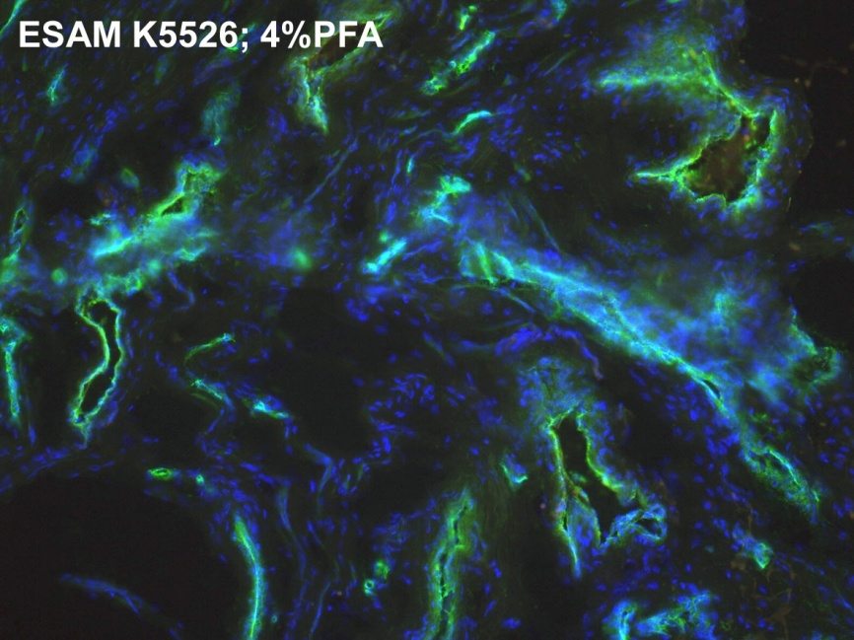
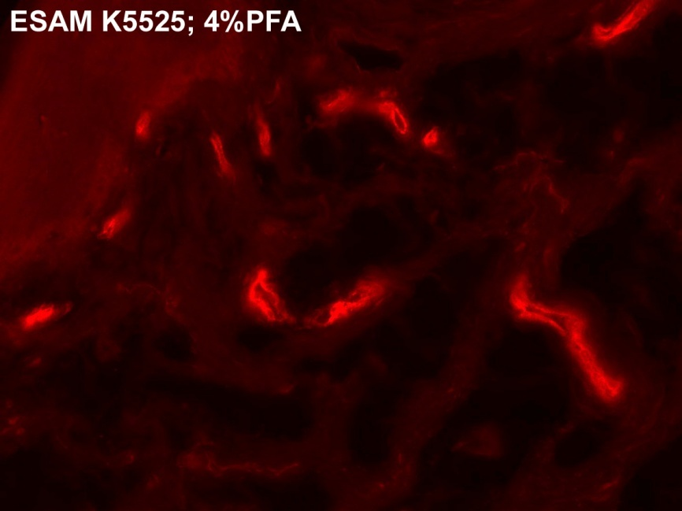
ReliaTech GmbH
Rabbit anti-human ESAM
„Endothelial cell-selective adhesion molecule“
(Cat #102-PA42S/-PA42)
Immunofluorescence staining (green, red) using RELIATech’s polyclonal antibody directed against human ESAM (Cat# 102-PA42). You see the staining of vascular endothelial cells of human foreskin.
The experiment was performed by the research group of Prof. Dr. J. Wilting, University Göttingen, Germany.
http://www.reliatech.de / orders@reliatech.de

